Slide 1





Insurance Analytics Project
Group-2

Slide 2
Team Members
Sripada Dilip Kumar
Akash Bakshi
Sanskriti Ankush Watkar
K. Sai Tharun
Koduru Harish Goud

Slide 3

Agenda
Objectives
Power BI Dashboard
KPIs and Insights
Tableau Dashboard
Excel Dashboard
Summary
SQL Queries Output

Slide 4
Objectives
Gain a comprehensive understanding of each branch's business performance, including that of its account executives, by reviewing their target budgets, achievements, and invoices. | Monitor the revenue generated by each branch and individual employee against their assigned targets. | Measure and review each executive's performance against key performance indicators (KPIs) to clearly assess their contribution to the company’s overall success.
Implement real-time dashboards for continuous tracking of KPIs related to budgets, invoices, and achievements, allowing for ongoing performance monitoring. | Utilize insights from performance reviews to refine targets, improve processes, and drive overall company performance | Ensure that strategic goals are met and resources are allocated effectively by clearly tracking these KPIs.

Slide 5
KPIs Description
No of Invoices by Account Exec
Cross-Sell, New and Renewal Targets/ Achievements/Invoices
Yearly Meeting Count
The count of invoices generated by each account executive.
Reflects the activity and effectiveness of each executive in generating business that results in invoicing.
Target Budgets: The company’s overall budget is divided into specific targets for each income class (Cross-Sell, New, Renewal) assigned to account executives.
Invoices: Monitors the volume, accuracy, and timeliness of invoices managed by each branch and its executives.
Achievements: Compares the actual revenue generated by the branch and its executives against the budgeted targets across different income categories.
The total number of meetings conducted by the branch over the year.
Tracks engagement and effort in client and prospect meetings, which contribute to relationship-building and sales opportunities.
Stage Funnel by Revenue
No of meetings by Account Executives
Top Open Opportunity
A visual representation of sales funnel stages (opportunity, proposal, closed) segmented by revenue.
Provides insight into the distribution of revenue opportunities throughout the sales process, helping identify potential bottlenecks or areas for improvement.
The total meetings attended by account executives.
Highlights which employees regularly attend meetings and which ones are frequently absent.
The most promising open opportunities, typically ranked by potential revenue or strategic importance.
Highlights key opportunities that are still active and require focus to convert into sales.

Slide 6
KPIs calculations
Target Budgets Calculated by totaling the amounts for each income class from the Individual Budgets dataset | Placed Achievement Revenue achieved from Brokerage + Revenue achieved from fees | Invoiced Achievement Calculated by totaling the amounts for each income class from the Invoice dataset.
Percentage of Achievement for Placed Achieved Revenue /Budgeted Revenue | Percentage of Achievement for Invoice Achieved Revenue from Invoice / Budgeted Revenue | Open Opportunity Opportunities with respect to Propose Solution and Qualify opportunity but not with respective to Negotiation

Slide 7
KPI Insights
Targets, Achievements, and Invoice
Meetings
Opportunities
Total Target – 52.07M
Total Meetings – 34
Total Opportunity – 49
Total Achieved – 35.08M (67.37%)
2019 – 3 (8.82%)
Open Opportunity – 44 (89.79%)
Total Invoiced – 11.66M (22.39%)
2020 – 31 (91.17%)
Closed Opportunity -5 (10.20%)

Slide 8
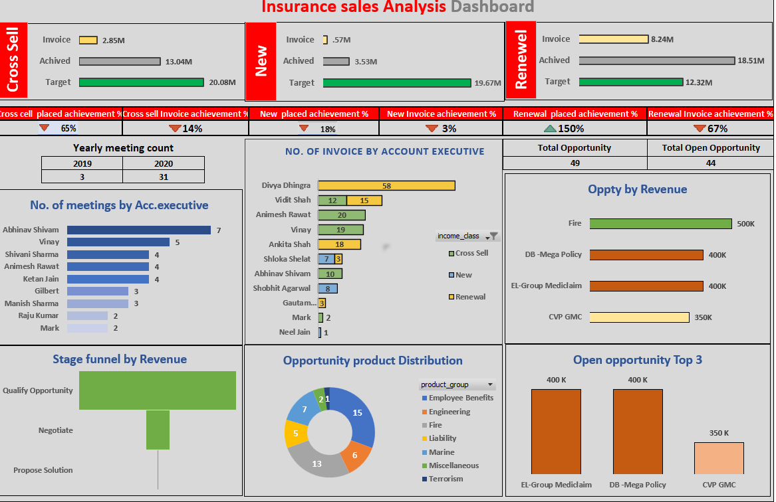
Excel Dashboard

Slide 9
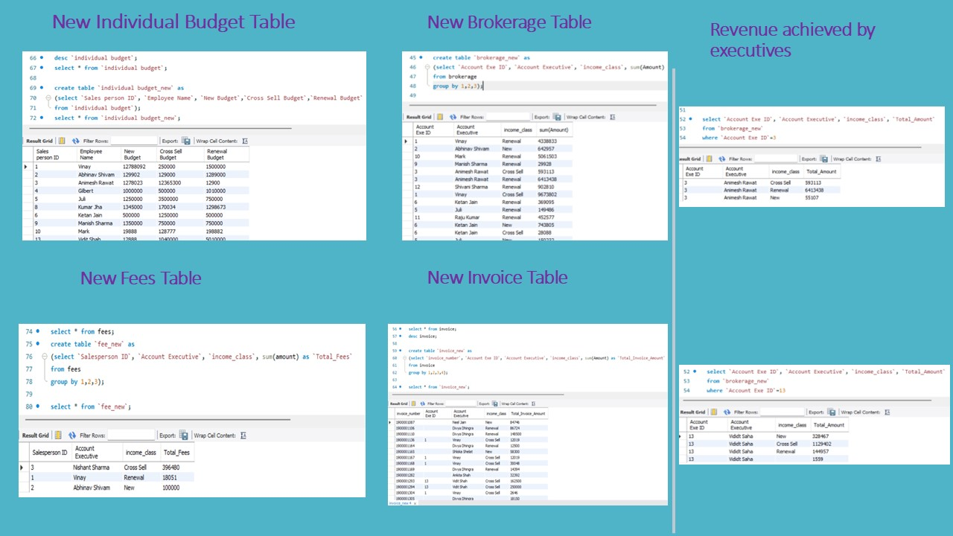
SQL Queries

Slide 10
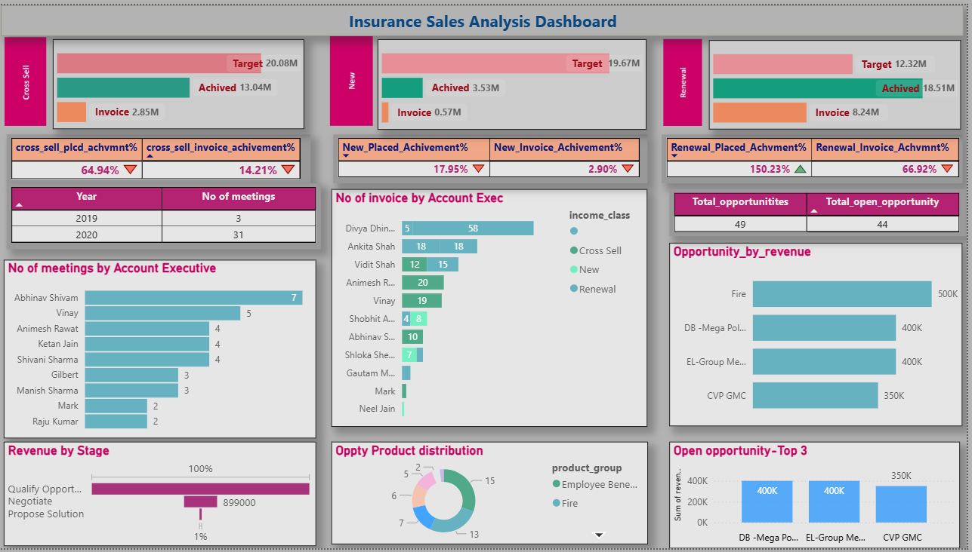
Power BI Dashboard

Slide 11
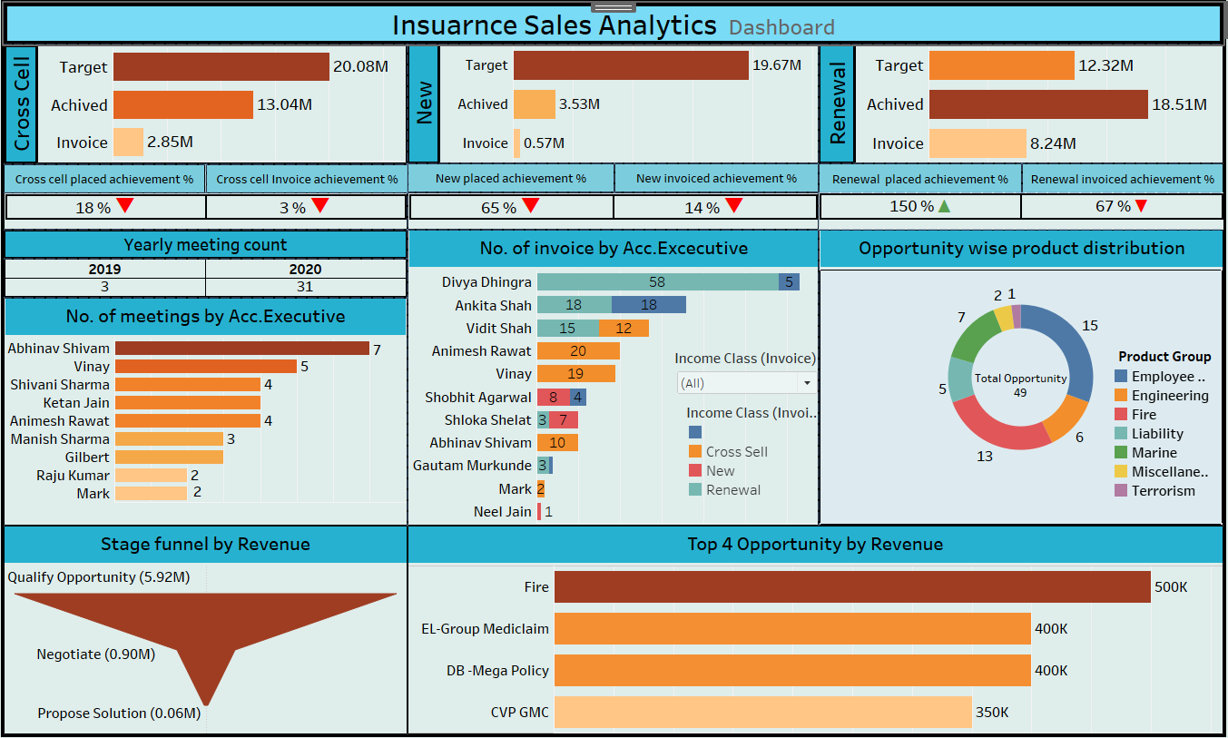
Tableau Dashboard

Slide 12


Insights and Observations
Only the Renewal Income class achieved revenue above the target with 150.23%
Analysis indicates that executives were unsuccessful in attracting new customers, but customer retention was good.
Renewal had the highest average Count of invoices of 19.40, followed by Cross Sell, and New.
Abhinav Shivam attended the most meetings (7) compared to other employees. Notably, he exceeded revenue targets in all three income classes.
Fire opportunity had a maximum revenue of 500K.

Slide 13

Summary
The financial analysis indicates overall financial Implementations and the recommended actions that could help improve financial stability, optimize performance, and achieve long-term growth objectives.
Steps to Follow
Action Plan: Develop a detailed action plan based on the recommendations.
Follow-up: Schedule regular reviews to monitor progress and adjust strategies as needed.
Meetings: More focus on the weekly meetings.

Slide 14
Thank You!

